Slide 1
Wizard Session WQL Performance
Do you wanna go faster?!

Slide 2
Agenda
Measuring Performance
Optimizing Performance

Slide 3
Why Bother?
Value
User Experience
Scalability
Approach
Mainly Inbound Endpoints
Prioritize High-Usage Pages
Iterative, A vs. B Approach
One-Second Rule
Timing
Near the End of Build and BEFORE User Testing

Slide 4
Measure You Must!
Turn on Performance Logging
Executing a Statement
Review the Results
Task: Edit Report Performance Log Settings
Select WQL Log Tab
Enter Data Source
Enter the “Log Until Date/Time”
Task: View WQL Query Result
GET/POST API
Task: View Report Performance Logs
Identify Bottlenecks

Slide 5
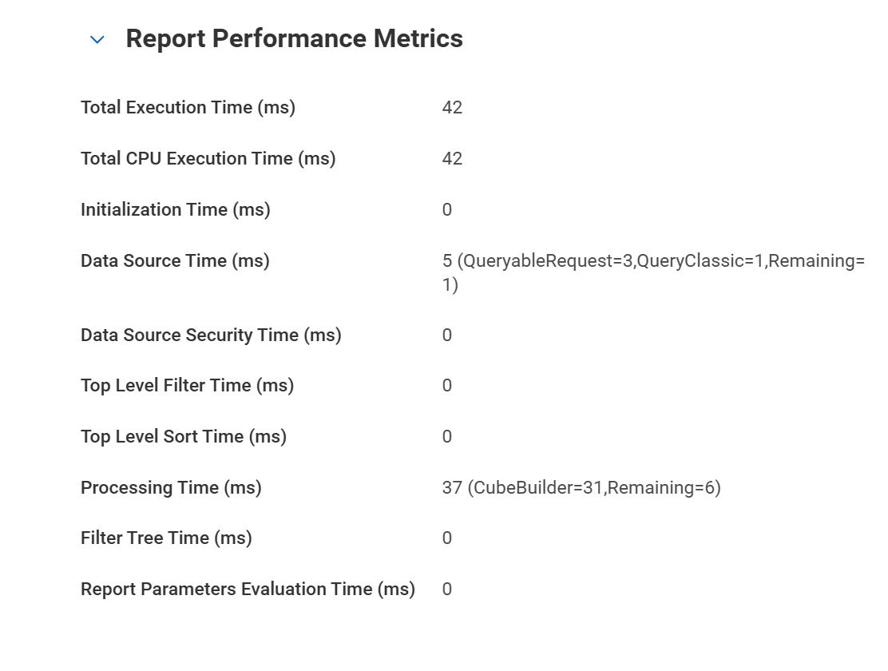
Reading the Results

Slide 6
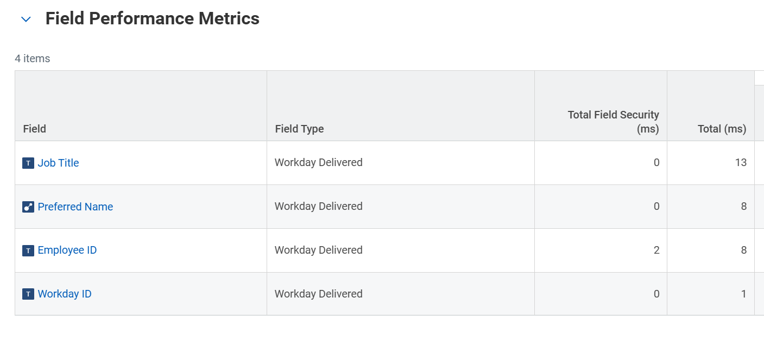
More Results

Slide 7
API Overhead
WQL Execution Time (ms) | REST Execution Time (ms) | API Overhead
205 | 1082 | 877
44 | 406 | 362
44 | 379 | 335
39 | 395 | 356
44 | 391 | 347
44 | 402 | 358
40 | 387 | 347
42 | 398 | 356
44 | 414 | 370
43 | 395 | 352

Slide 8
Sample Optimization Strategies

Slide 9
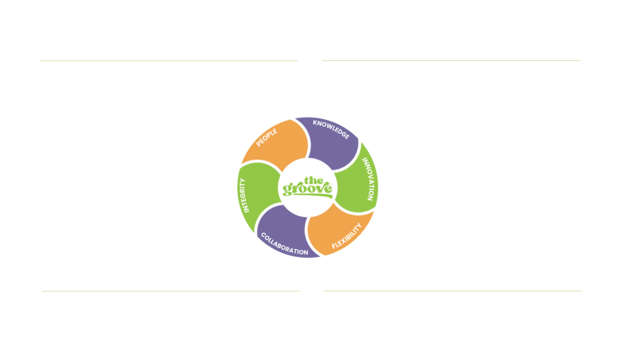
What Can We Do?
Find a Better DataSource
Manage Security
Approach Creatively
Handle Joins

Slide 10
Find a Better Datasource
AllWorkers
Everything, but SLOW
WorkersForHCMReporting
Indexed, but more limited
WorkerFromName
Very limited but VERY fast

Slide 11
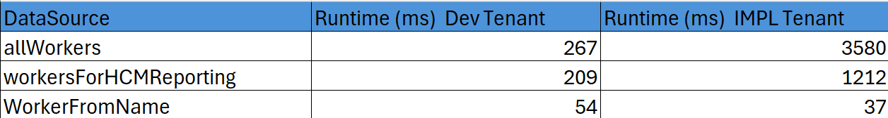
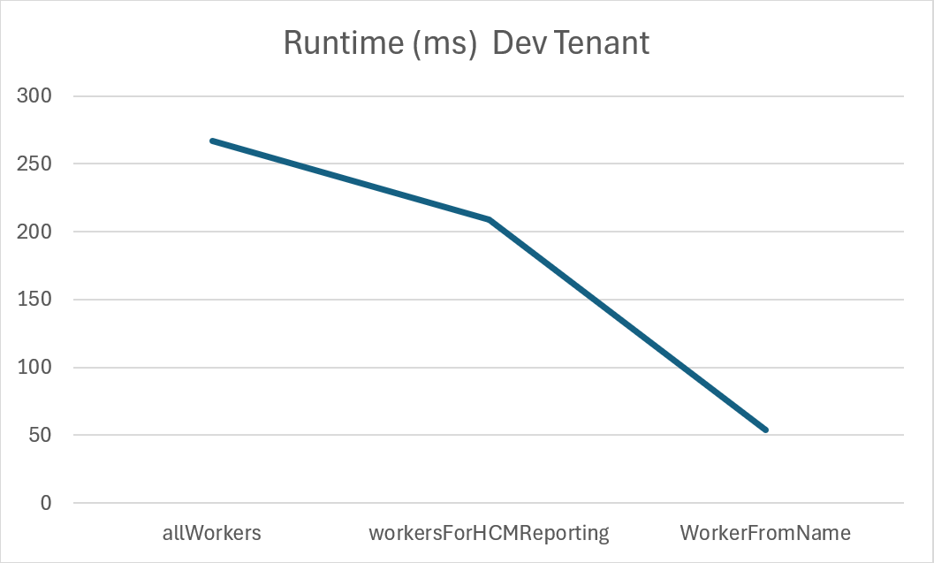
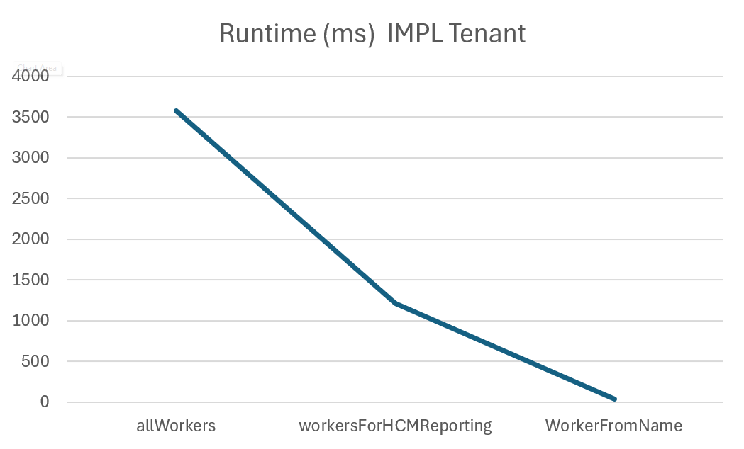
Find a Better Datasource - Scalability

Slide 12
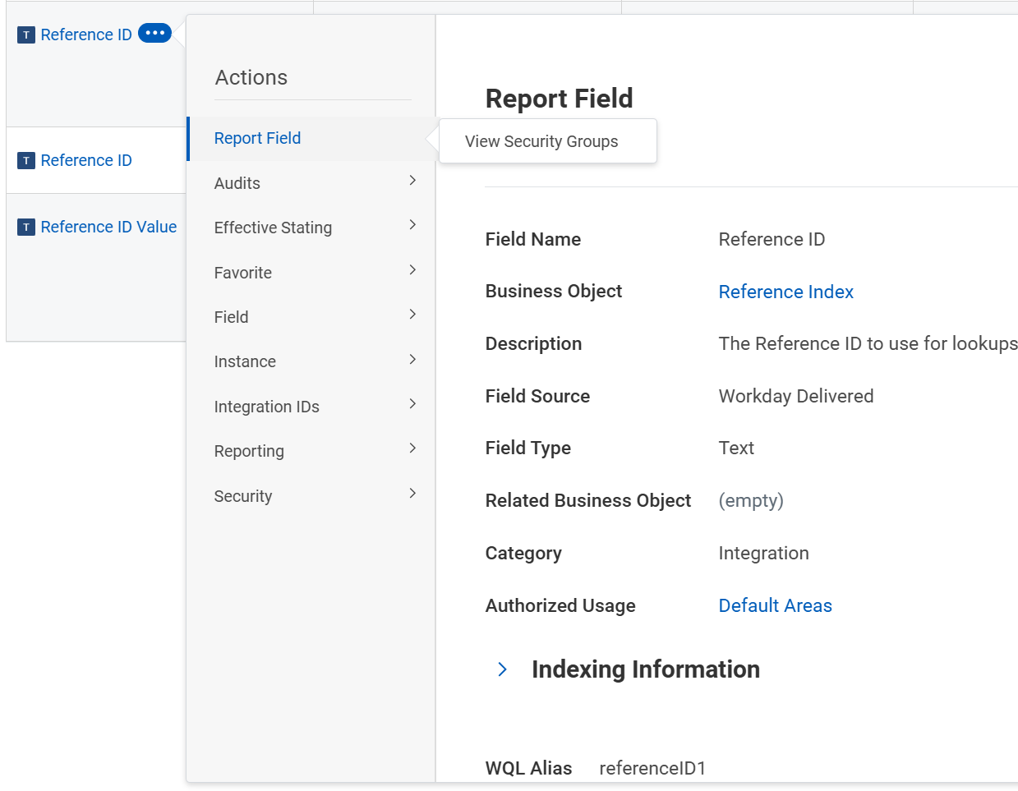
Finding a WQL Alias - Field

Slide 13
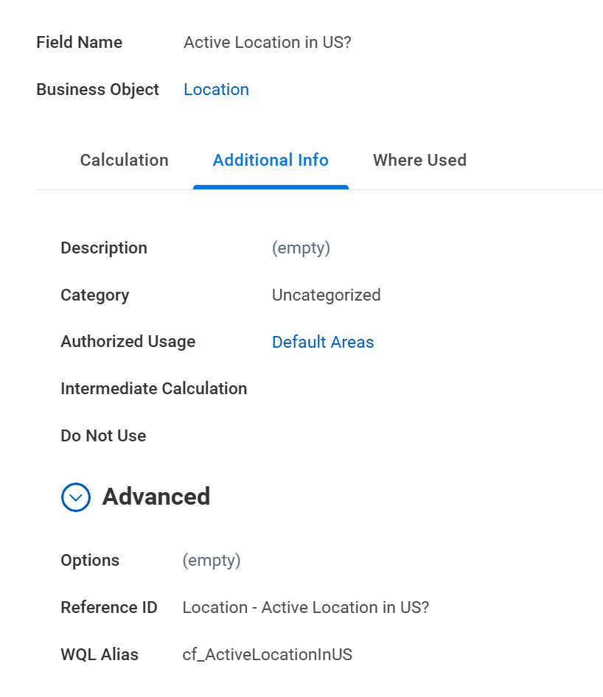
Finding a WQL Alias – Calc Field

Slide 14
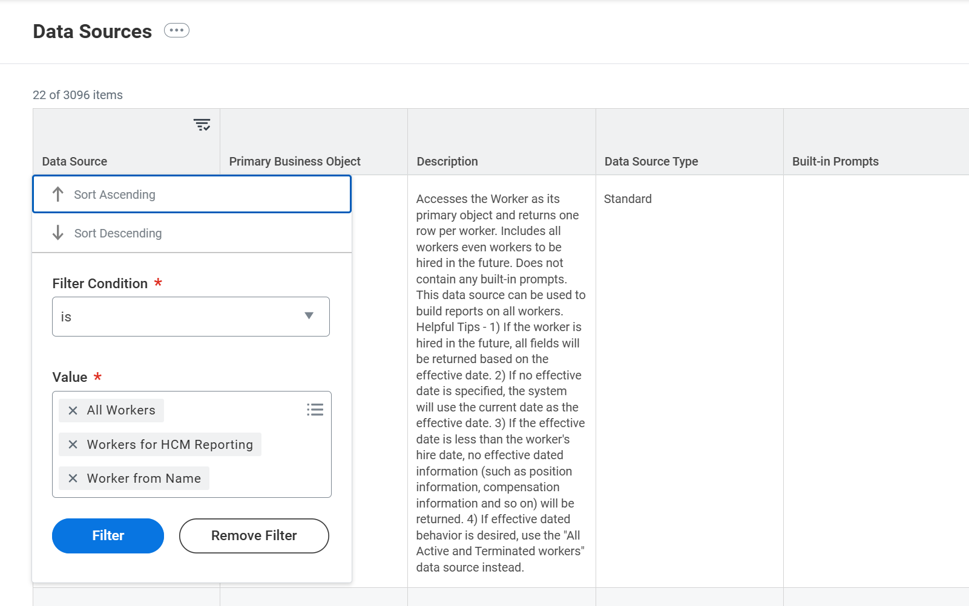
Finding a WQL Alias – Data Sources Report

Slide 15
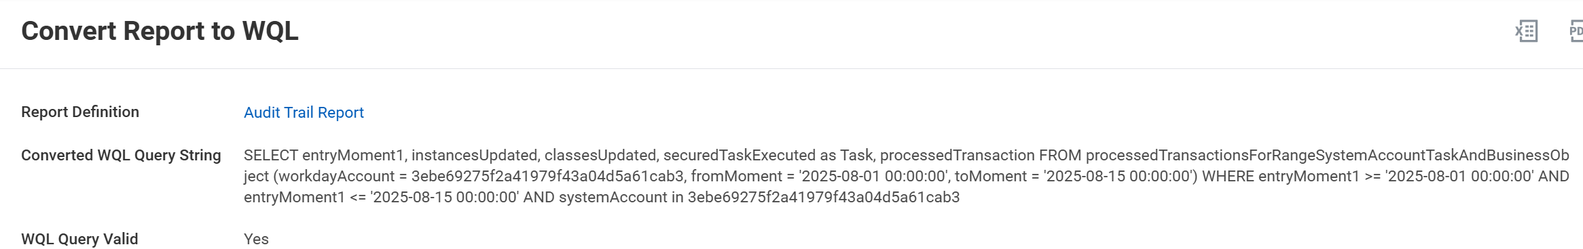
Finding a WQL Alias – Convert Report to WQL

Slide 16
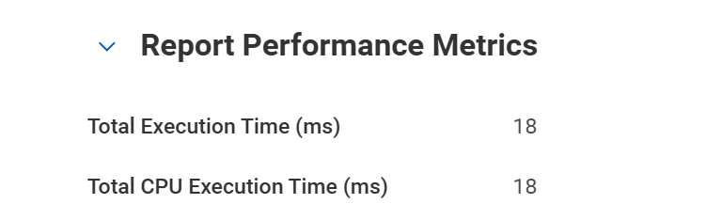
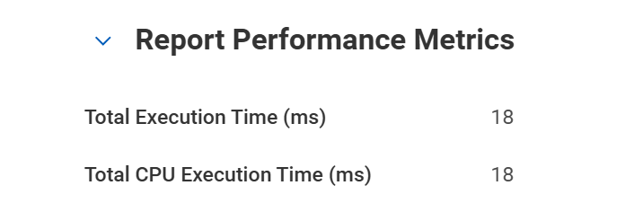
Myth: Order of Where Clause
Where Clauses are NOT sensitive to Order
select relevantWorker, someText from tws_wqlsourcecode_nkhlsq_tWSWQLConstrainedSecurities where relevantWorker in (3a37558d68944bf394fad59ff267f4a1) and someText contains 'f3'

Slide 17
Manage Complex Security
Iterative processing is slow
Integration system user.
Intersection, Constrained, Unconstrained
Security is applied at the field level.
There is no such thing as a free lunch.
Be careful!

Slide 18
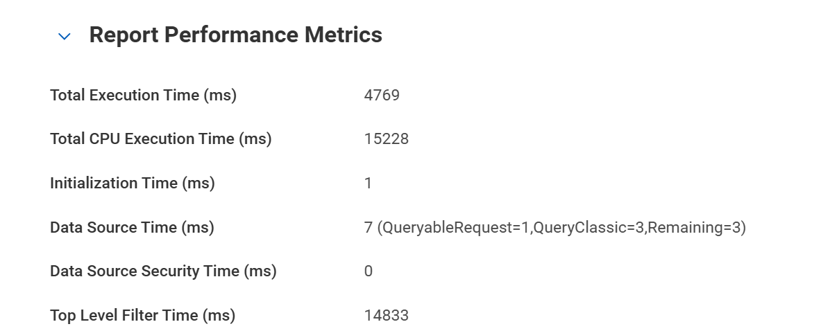
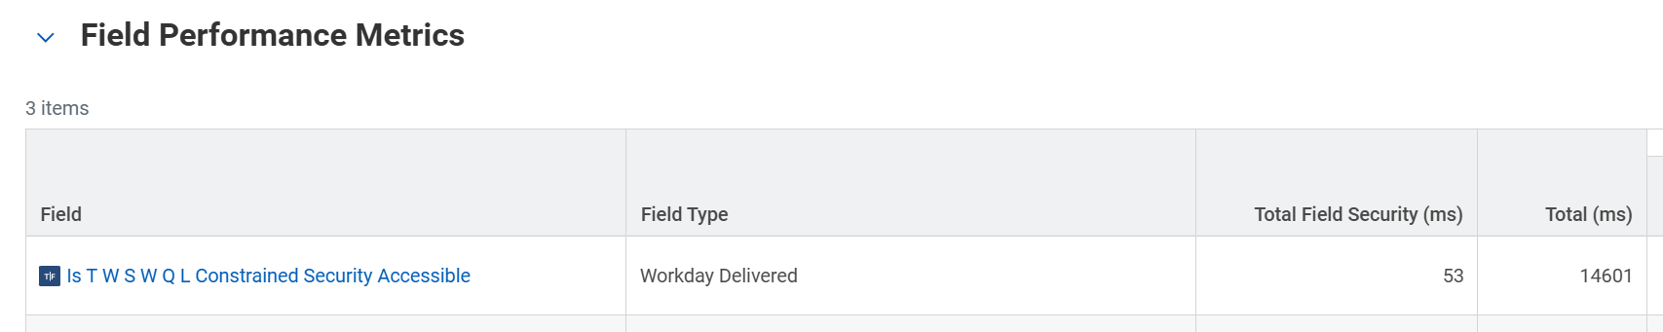
Manage Complex Security
Constrained Call returning 306 of 30,000 instances

Slide 19
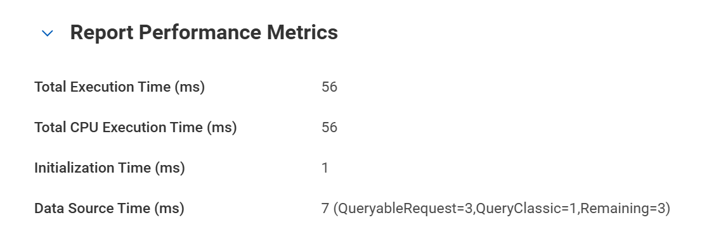
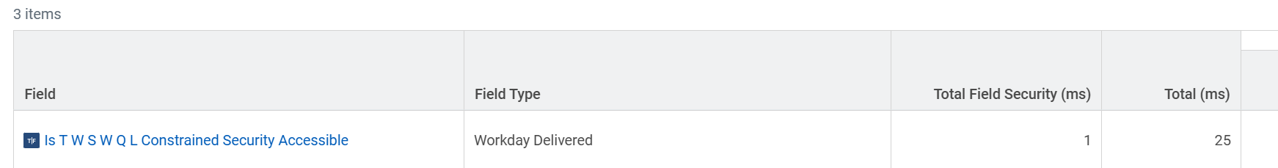
Manage Complex Security – 100x faster!
Filtered Call returning 306 of 30,000 instances

Slide 20
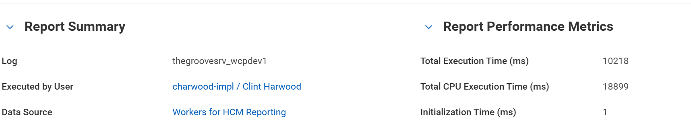
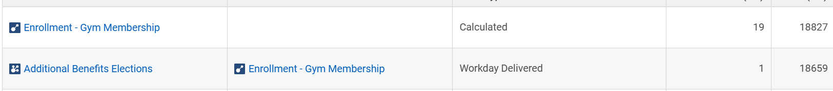
Baseline : A Slow Join In A Dev Tenent
SELECT employeeID,cf_Enrollment_GymMembership FROM workersForHCMReporting (dataSourceFilter = allActiveWorkers) WHERE (employeeType_AllPositions in (9459f5e6f1084433b767c7901ec04416))

Slide 21
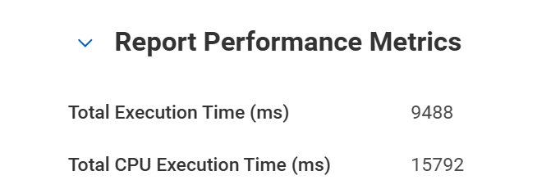
Joins: RBO vs Calc Field – 10% Faster
Generally about 10% difference
Sometimes the Calc Field is FASTER
Whichever reduces iterated processing
Lookup Related Values

Slide 22
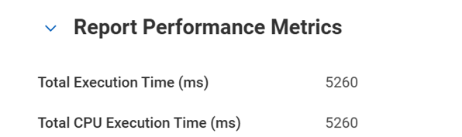
Joins: Try RaaS– 50% Faster
Lookup Related Values
Against a target with more than 10,000 instances
RaaS will be faster by a lot

Slide 23
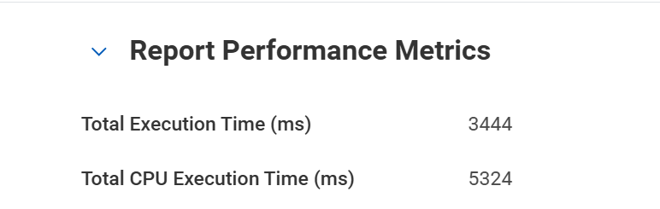
Approach Creatively -70% Faster
Start with the smallest dataset, not the largest
How many Instances are you looking at in total?
Joins will be the biggest slowdown
Iterative processing is slow
Calc Fields
Derived fields

Slide 24
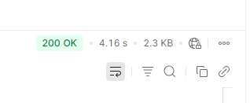
Joins: Orchestration/Studio – 60% Faster
Pull each dataset exactly once
Streaming transformation
Studio has more power
Studio has more overhead
Orchestration works better with Extend

